Slide 1

Ph.D. Progress Seminar on
Towards sustainable development energy management: Federated Learning Block chain Integration
By
Aditi Agrawal
(DT23CSE017)
Under guidance of
Dr. PVN Prashanth
Department of Computer Science and Engineering
Visvesvaraya National Institute of Technology
Nagpur 440010 (India)
2023-2024

Slide 2
Content
Course Work Done
Introduction
Motivation
Types of Problems
Related Work
Research Gap
Challenges
Research Plan
References

Slide 3
Course Work Done
Code | Course title | Opt | Credit | Grades
CSL502 | Deep Learning | DE | 4 | BC
IDC501 | Research Methodology | AE | 0 | SS
 |  |  | CGPA | 7

Slide 4
Introduction to Microgrids
A microgrid is a localized group of electricity sources (generation, storage) and loads (consumers) that can operate independently or in conjunction with the main grid.
It can be as small as a single building or as large as a neighborhood, campus, or industrial complex.
Microgrids have the capability to disconnect from the main grid and operate autonomously (island mode) during grid outages or emergencies.
Microgrids typically integrate various distributed energy resources (DERs) such as solar PV, wind turbines, batteries, and combined heat and power (CHP) systems
The primary objectives of microgrids include improving energy resilience, enhancing local energy reliability, integrating renewable energy sources, and optimizing energy usage within a localized area.

Slide 5
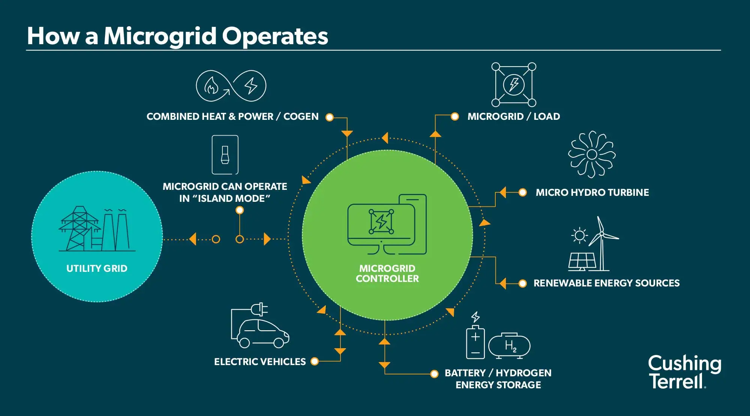

Slide 6
Motivation
Microgrids are increasingly seen as a flexible and sustainable solution to energy challenges.
Offering benefits such as reduced carbon emissions.
Increased energy security.
Improved integration of renewable energy sources into the electricity grid.
They can also support local communities and businesses in achieving energy independence and cost savings.

Slide 7
Types of problems
Cybersecurity:
Protecting the grid from cyber-attacks and unauthorized access.
Ensuring data integrity and secure communication.
Energy Storage:
Efficiently storing excess energy and releasing it when needed.
Managing battery life cycles and storage capacity.
Grid Management:
Real-time monitoring and control of grid operations.
Optimizing the distribution of electricity to minimize losses.
Infrastructure Modernization:
Upgrading aging grid infrastructure.
Implementing smart technologies and advanced metering.
Demand Response:
Balancing supply and demand in real-time.
Incentivizing consumers to reduce or shift their power usage during peak times.
Reliability:
Ensuring consistent and stable power supply.
Minimizing outages and quickly restoring power after disruptions.

Slide 8
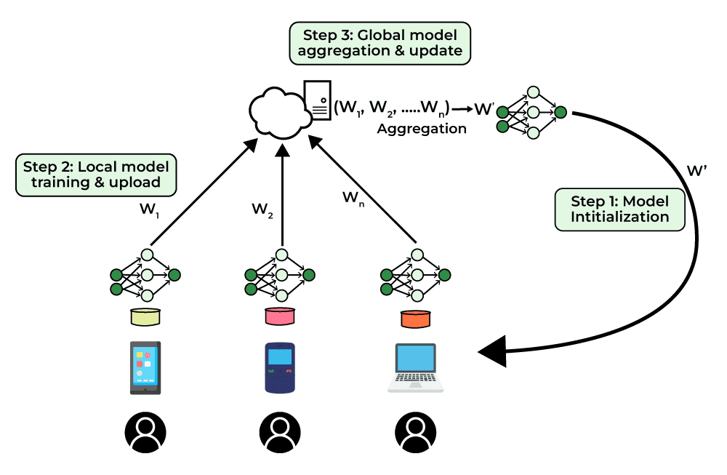
Federated Learning
Federated learning is a collaborative approach to machine learning that enables training models across decentralized devices while preserving data privacy and security, making it well-suited for applications in sensitive and distributed environments
Federated learning can be applied to microgrid management to enhance data privacy, improve model accuracy, maintain system decentralization, and optimize energy efficiency, making it a promising technology for advancing smart grid applications.
Problems in using Federated Learning
Data privacy becomes a major concern as customer data is often used to train data driven models.
Data owners may not be willing to share their data to a centralized server for model training, mainly due to privacy, commercial competition, and technical barrier reasons.
Data Heterogeneity as Energy consumption patterns can vary significantly across different regions and demographics.

Slide 9
Related Work
In [1] it is discussed Blockchain technology has drawn the attention of researchers in various fields of data science as a safe and low-cost platform to track a large number of eventual transactions. Such a technique is adaptable to the renewable energy-trade sector, which suffers from security and trustworthy issues. Having a decentralized energy infrastructure, that is supported by blockchain and artificial intelligence, enables smart and secure microgrid energy trading. As such a robust collaboration solution between consumers, businesses, and suppliers must be both secure and sustainable.
In [2] FL enables the ML model training at data silos under the coordination of a central server, eliminating communication overhead and without sharing raw data. They provide a thematic classification of FL to address a variety of energy-related problems, including demand response, identification, prediction, and federated optimizations. It describes the taxonomy in detail and conclude with a discussion of various aspects, including challenges, opportunities, and limitations in its energy informatics applications, such as energy system modeling and design, privacy, and evolution.

Slide 10
Related Work
In[3] it is seen that Federated learning is a recent framework for communication-efficient training of machine learning models over the data collected, stored, and processed by millions of wireless devices. In this paper, It introduces a sustainable machine learning framework for federated learning, using rechargeable devices that can collect energy from the ambient environment. In particular, it proposes a practical federated learning framework that utilizes intermittent energy arrivals for training, with provable convergence guarantees. Framework can be applied to both cross-device and cross-silo federated learning settings, including federated learning in wireless edge networks and the Internet-of-Things.
In [4] federated learning-based energy forecasting and trading platform tailored for decentralized renewable energy markets is proposed. Leveraging the federated learning framework, Platform enables accurate and privacy-preserving energy forecasting while facilitating efficient energy trading and grid management. Through empirical evaluations using real-world data, It demonstrates the superior performance of its federated learning model in predicting energy generation levels compared to traditional baseline models. Overall, its federated learning-based energy forecasting and trading platform offers a transformative solution for decentralized renewable energy markets, promoting efficiency, reliability, and sustainability

Slide 11
Research Gap
Improving Data Privacy and Security: Implementing federated learning to train AI models on decentralized data
sources without compromising privacy.
Enhancing Transparency and Trust: Utilizing blockchain for transparent and immutable energy transaction records,
ensuring accountability and trust in sustainable energy practices.
Optimizing Energy Distribution: Developing algorithms that use federated learning to optimize energy distribution
networks based on real-time, localized data, contributing to energy efficiency and sustainability goals.
Promoting Collaboration: Facilitating collaborative efforts among energy stakeholders by providing a secure
and decentralized platform for data sharing and decision-making.

Slide 12
Problem Statement
Towards sustainable development energy management: Federated Learning Block chain Integration
Objective:
Optimizing Energy Distribution: Developing algorithms that use federated learning to optimize energy distribution networks based on real-time, localized data, contributing to energy efficiency and sustainability goals.

Slide 13
Challenges
Data Privacy and Security: Federated learning relies on training models across decentralized data sources while preserving data privacy.
Ensuring that sensitive energy consumption data remains secure and anonymized throughout the training process is crucial.
Data Heterogeneity: Energy consumption patterns can vary significantly across different regions and demographics. Federated learning algorithms must effectively handle diverse and potentially uneven data distributions to produce robust and generalized models.
Real-Time Processing: Energy distribution networks require quick decision-making based on real-time data. Federated learning algorithms need to process and incorporate new data updates rapidly without compromising the accuracy of the model.
Communication and Coordination: Federated learning involves communication between multiple entities (e.g., energy providers, consumers,
regulatory bodies) which may have different priorities and constraints. Ensuring effective coordination and communication protocols is essential for successful model training and deployment.
Model Aggregation and Fusion: Federated learning involves aggregating model updates from multiple decentralized sources. Techniques for aggregating and fusing these updates while maintaining model accuracy and convergence are critical.
Scalability and Infrastructure: Implementing federated learning in large-scale energy distribution networks requires robust infrastructure capable of handling the computational and communication demands of training and deploying models across distributed nodes.
Regulatory and Compliance Challenges: Energy distribution is often subject to regulatory frameworks and compliance requirements. Ensuring that federated learning models comply with relevant regulations while still achieving optimal efficiency and sustainability
goals is a significant challenge

Slide 14
Research Plan
Work | Duration | Remark
Course work and Literature review | 6 Months | Completed 2 course.
Course work and Module 1 | 6 Months | Will complete 1 course and implement module 1 in which consumer’s demand is fixed and storing extra generated energy.

Slide 15
References
Safa Otoum , Member, IEEE, Ismaeel Al Ridhawi , Senior Member, IEEE, and Hussein Mouftah , Life Fellow, IEEE“A Federated Learning and Blockchain-Enabled Sustainable Energy Trade at the Edge: A Framework for Industry 4.0” IEEE INTERNET OF THINGS JOURNAL, VOL. 10, NO. 4, 15 FEBRUARY 2023
Xu Cheng ,Chendan Li ,Xiufeng ,“A Review of Federated Learning in Energy Systems” 2022 IEEE IAS Industrial and Commercial Power System Asia.
Ba¸sak Güler ,Aylin Yener “A Framework for Sustainable Federated Learning” 2021 19th International Symposium on Modeling and Optimization in Mobile, Ad hoc, and Wireless Networks (WiOpt)
Ramakrishna S S ,Syed Riyaz Ahammed ,Polamarasetty P , Sudheer Reddy.J , Ahmed Ali , Md. Dr. Praveena Akki ,Hushein R , Dr.Sagunthala “Federated Learning-Based Energy Forecasting and Trading Platform for Decentralized Renewable Energy Markets ” 12th International Conference on Smart Grid May, 27-29, 2024, Setubal, PORTUGAL.
Mahdi, Baqer Saleh, Nasri Sulaiman, Mohanad Abd Shehab, Suhaidi Shafie, Hashim Hizam, and Siti Lailatul Mohd Hassan. "Optimization of Operating Cost and Energy Consumption in a Smart Grid." IEEE Access (2024).
Alsirhani, Amjad, Mohammed Mujib Alshahrani, Abdulwahab Abukwaik, Ahmed I. Taloba, Rasha M. Abd El-Aziz, and Mostafa Salem. "A novel approach to predicting the stability of the smart grid utilizing MLP-ELM technique." Alexandria Engineering Journal 74 (2023): 495-508.
Boiarkin, Veniamin, Muttukrishnan Rajarajan, Jafar Al-Zaili, and Waqar Asif. "A novel dynamic pricing model for a microgrid of prosumers with photovoltaic systems." Applied Energy 342 (2023): 121148.
Alves, Guilherme Henrique, Geraldo Caixeta Guimarães, and Fabricio Augusto Matheus Moura. "Battery storage systems control strategies with intelligent algorithms in microgrids with dynamic pricing." Energies 16, no. 14 (2023): 5262.
Nayak, Shravan, Chanakya Ajit Ekbote, Annanya Pratap Singh Chauhan, Raghuram Bharadwaj Diddigi, Prishita Ray, Abhinava Sikdar, Sai Koti Reddy Danda, and Shalabh Bhatnagar. "Stochastic game frameworks for efficient energy management in microgrid networks." In 2020 IEEE PES Innovative Smart Grid Technologies Europe (ISGT-Europe), pp. 116-120. IEEE, 2020.
Safa Otoum , Member, IEEE, Ismaeel Al Ridhawi , Senior Member, IEEE, and Hussein Mouftah , Life Fellow, IEEE“A Federated Learning and Blockchain-Enabled Sustainable Energy Trade at the Edge: A Framework for Industry 4.0” IEEE INTERNET OF THINGS JOURNAL, VOL. 10, NO. 4, 15 FEBRUARY 2023

Slide 16
THANK YOU

